Slide 1
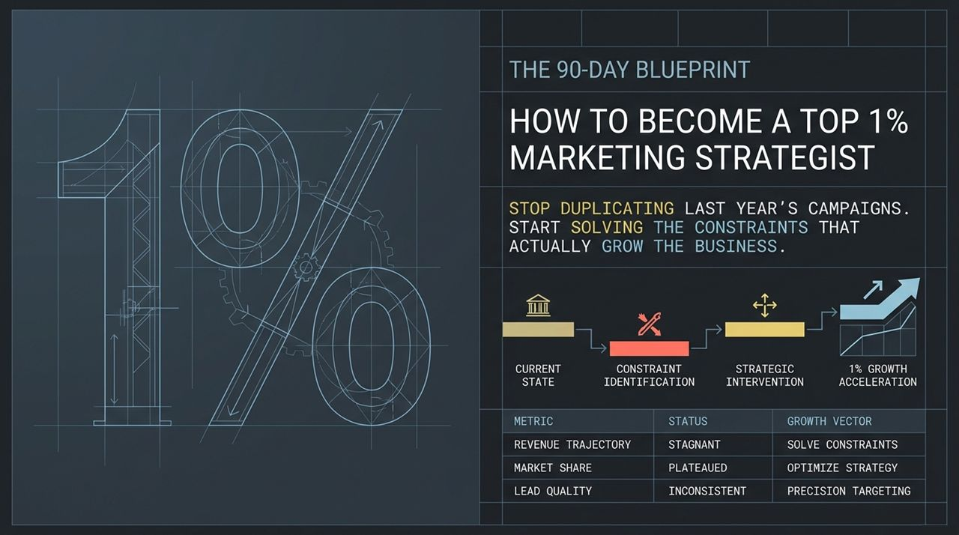
Notes:
Welcome, everyone. Today we are unpacking The 90-Day Blueprint designed to transform how you practice marketing and elevate you into the top 1% of marketing strategists.
Most marketing teams fall into a very comfortable, lazy trap: when a new quarter or new year rolls around, they find last year’s campaign, hit ‘duplicate,’ update the dates, and call it a strategy. They measure success by whether campaigns went live on time, rather than whether the business actually grew.
Over the next 90 days, we are going to break that pattern. As a top strategist, your job in the eyes of executive leadership is simple: grow the business. You do not achieve that by duplicating existing tactics or throwing random ideas at the wall. You achieve it by diagnosing the actual bottleneck in the system and fixing the specific constraint preventing growth.
https://www.youtube.com/watch?v=dgCSN-rnN0E

Slide 2
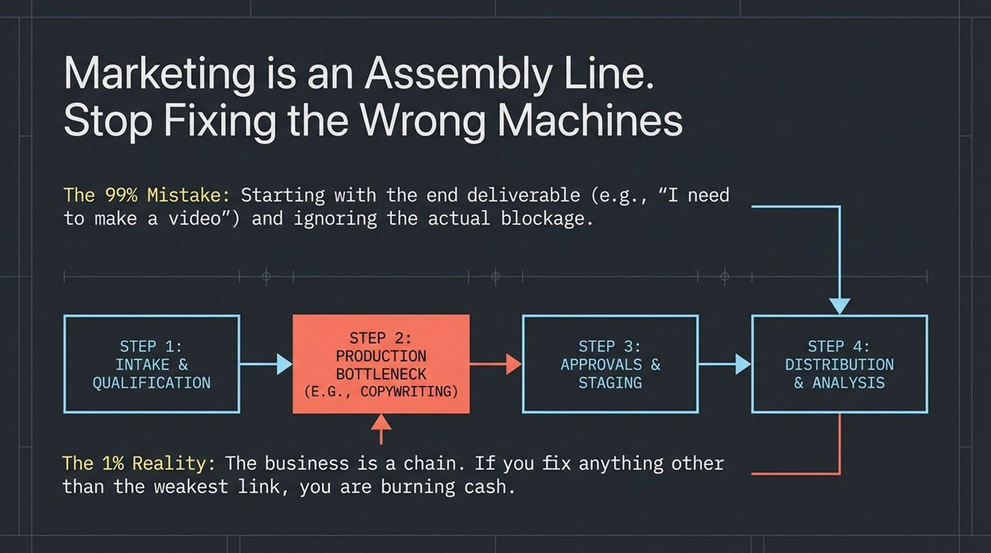
Notes:
To understand true marketing strategy, you have to adopt a specific mental model: Marketing is an assembly line.
This concept comes directly from Eliyahu Goldratt’s seminal book The Goal, which was made required reading for executives by Jeff Bezos. Goldratt introduced the Theory of Constraints: in any system or assembly line, output is strictly dictated by the single weakest link.
The 99% Mistake: Most marketers start with the end deliverable. They say, 'We need a video,' or 'We need to run Meta ads,' completely ignoring where the actual pipeline blockage lives.
The 1% Reality: If Step 2 (e.g., copywriting or conversion) is your primary bottleneck, spending double the money to push more leads through Step 1 (intake) does not generate more revenue—it simply burns cash and overburdens the system. If you optimize any part of the chain other than the primary constraint, you are wasting resources.

Slide 3
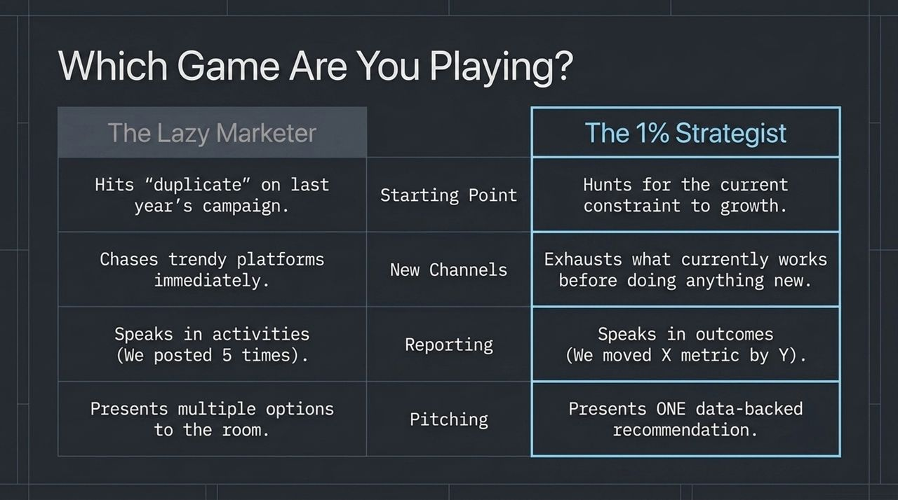
Notes:
Let’s look at the stark contrast between the Lazy Marketer and the 1% Strategist across four core areas:
Starting Point: The lazy marketer hits 'duplicate' on last year's campaign. The 1% strategist relentlessly audits data to hunt down the current constraint blocking growth.
New Channels: The lazy marketer jumps on every trendy platform immediately. The strategist exhausts and optimizes what currently works before testing anything new.
Reporting: The lazy marketer reports on activities—'We posted 5 times this week'. The strategist reports strictly in outcomes—'We moved X conversion metric by Y percentage'.
Pitching: The lazy marketer presents multiple options and lets the executive team choose. The strategist brings one data-backed recommendation with complete conviction.

Slide 4
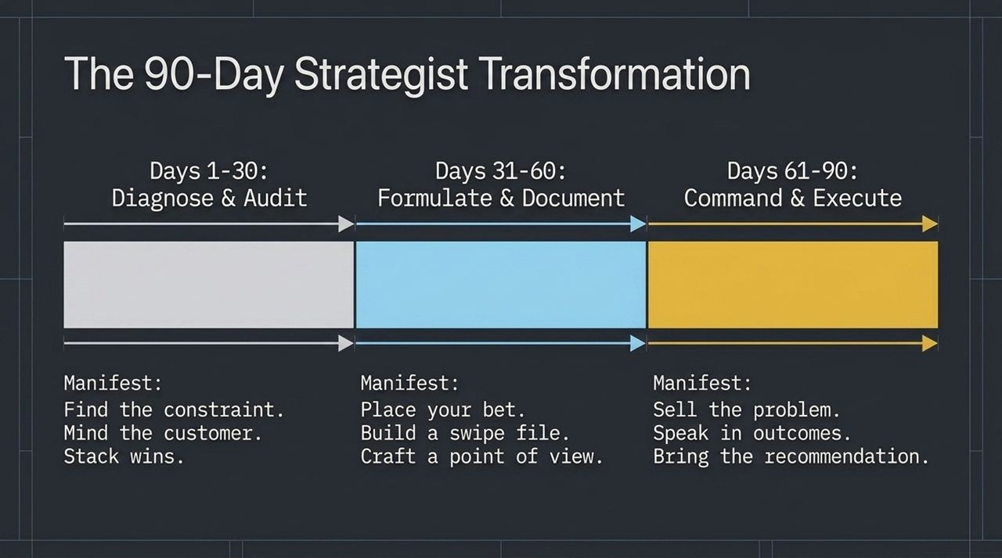
Notes:
Here is our 90-day execution framework split across three distinct 30-day phases:
Days 1–30: Diagnose & Audit. First, find the real constraint. Mind the customer's buying journey. Stack wins by auditing what’s already working before adding new channels.
Days 31–60: Formulate & Document. Define your strategy by explicitly placing a bet. Build a reasoning swipe file rather than a visual mood board. Craft a sharp, defensible Point of View (POV).
Days 61–90: Command & Execute. Sell the cost of the problem before showing any solution. Speak exclusively in outcome metrics. Bring one single, solid recommendation to the room.

Slide 5
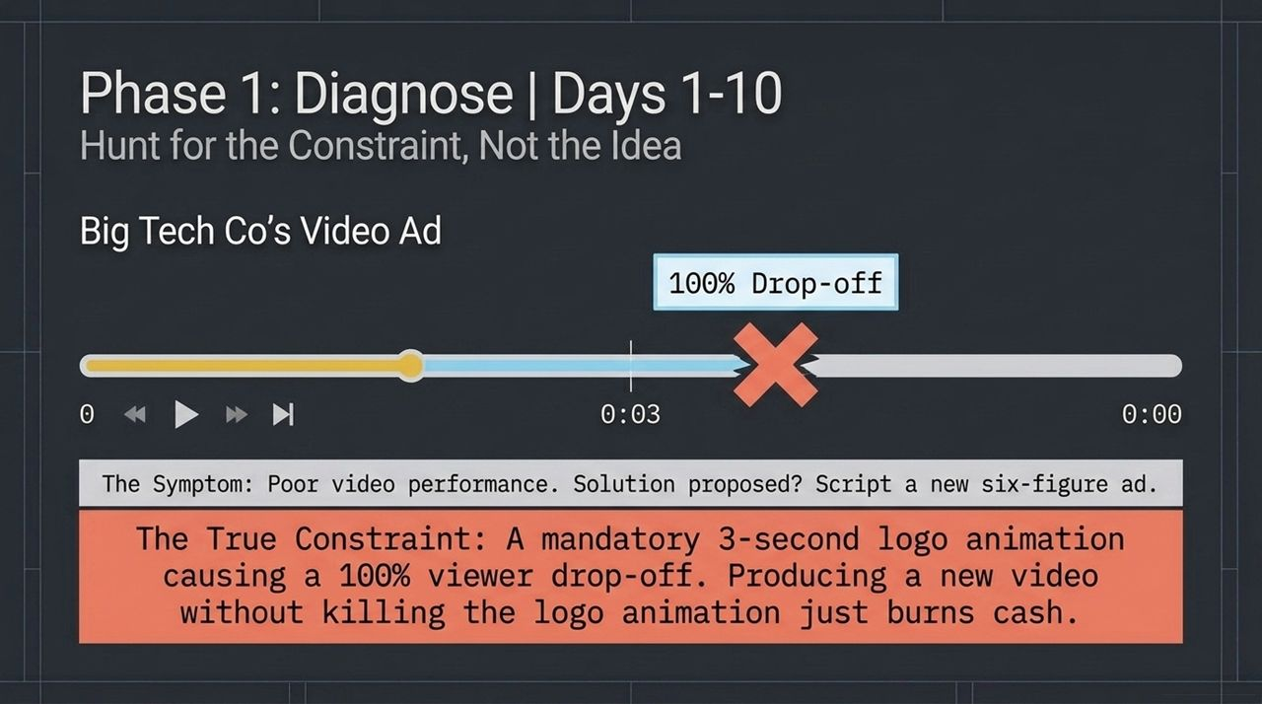
Notes:
In Days 1 to 10, your focus is to ignore 'creative ideas' and isolate the root constraint.
Consider this real-world example from a major tech company: A creative team wanted to script a brand-new six-figure ad campaign because current videos performed poorly. When audited, the data revealed a 100% viewer drop-off right at the 3-second mark.
Why? A mandatory 3-second brand logo animation was placed at the start of every video, signaling to users that it was an ad and driving them away instantly. The solution wasn't spending $100k on a new script; it was removing the logo animation. Fixing the true constraint saves cash and unlocks immediate growth.

Slide 6
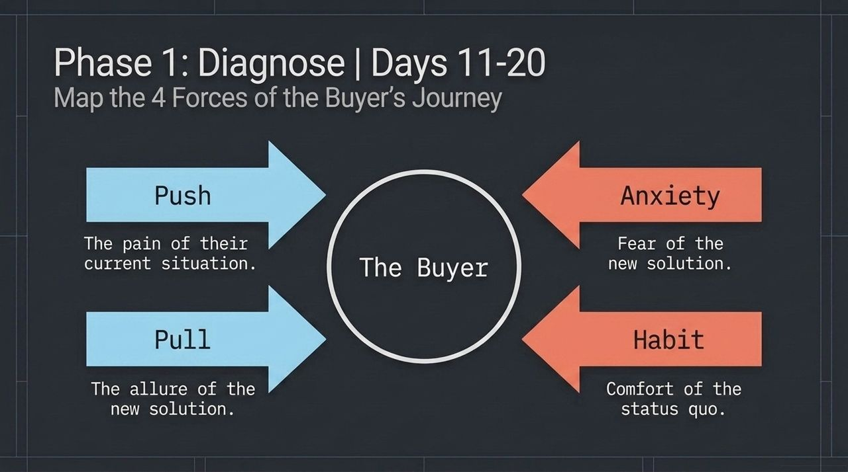
Notes:
During Days 11 to 20, you must get inside the mind of the customer behind the constraint. We use Bob Moesta’s Jobs-to-be-Done framework, which identifies four competing forces acting on every buyer:
Push: The pain of their current situation that pushes them away from status quo.
Pull: The allure and promise of the new solution.
Anxiety: The fear of switching or making a wrong purchase decision.
Habit: The comfortable inertia of doing nothing.
Your growth objective is to ensure Push + Pull heavily outweighs Anxiety + Habit. To execute this step, interview recent buyers and build a timeline of their friction points.

Slide 7
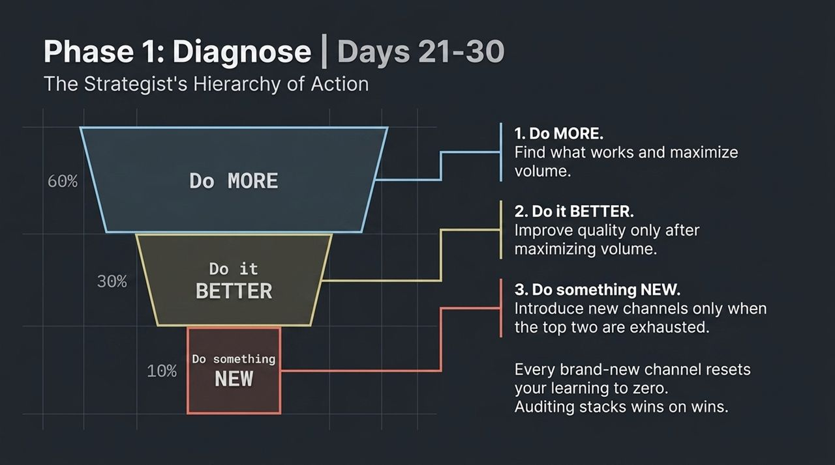
Notes:
For Days 21 to 30, implement the More > Better > New rule:
Do MORE (60% effort): Audit what is currently converting and scale its volume first.
Do it BETTER (30% effort): Optimize hooks, lighting, copy, or formats on existing winning assets.
Do something NEW (10% effort): Only test brand-new channels, tools, or formats after you have completely maxed out steps 1 and 2.
Starting a brand-new channel resets your learning curve to zero. Auditing and expanding existing winners stacks win upon win.

Slide 8
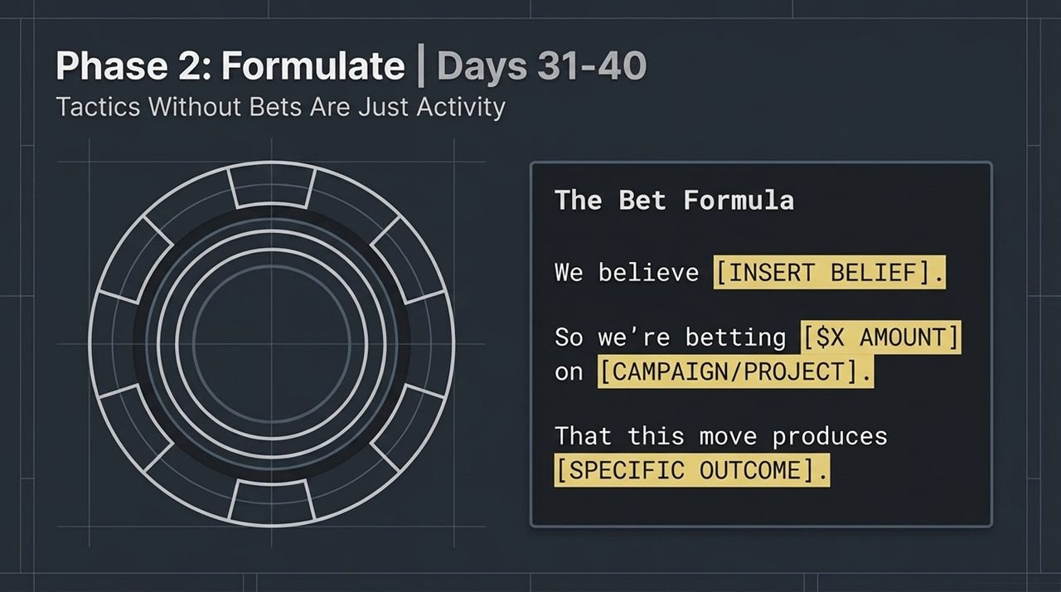
Notes:
Entering Phase 2, Days 31 to 40 require translating insights into actionable bets. As the saying goes: 'Insight becomes strategy the moment you wager time or money on it.'
Use the standardized Bet Formula:
'We believe [INSERT BELIEF]. So we're betting [$X AMOUNT] on [CAMPAIGN/PROJECT] that this move produces [SPECIFIC OUTCOME].’
Take Dollar Shave Club: Their viral video was just a tactic. The underlying bet was that men hated paying $22 for razors locked in drugstore cases and would prefer cheap subscriptions. When Unilever bought them for $1 billion, they bought the bet, not just the video.

Slide 9
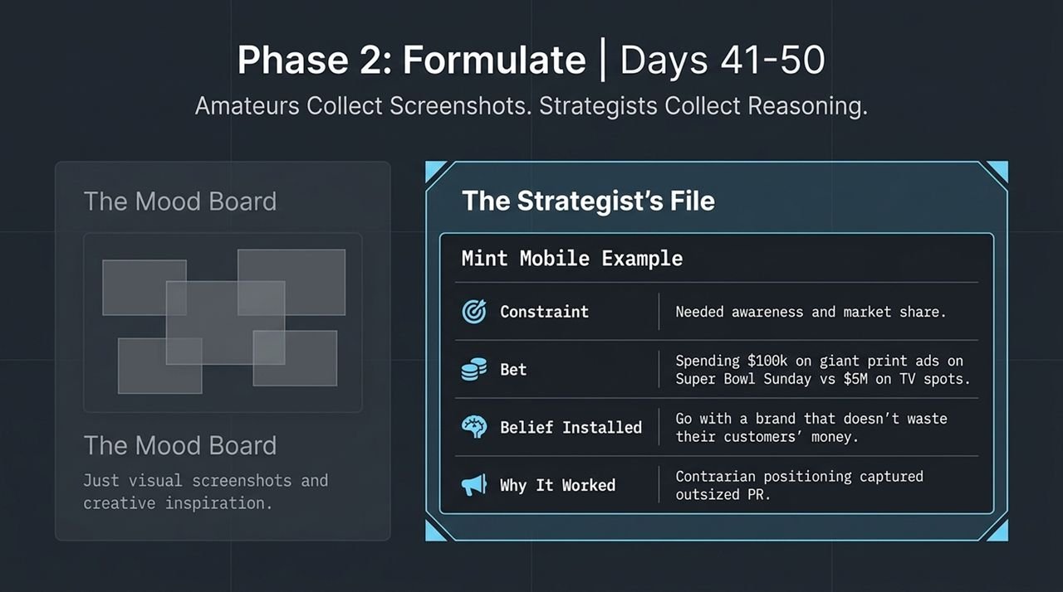
Notes:
In Days 41 to 50, build a strategic Swipe File. Amateurs collect visual screenshots and store them in mood boards—which are decorative, not strategic. Strategists collect the underlying business reasoning.
Document 4 lines for every winning campaign you study:
Constraint: What growth problem did they face?
Bet: What resource did they wager?
Belief Installed: What mindset did they create in the market?
Why It Worked: What was the core strategic driver?
Look at Mint Mobile: Instead of spending $5M on a Super Bowl TV spot, they spent $100k on giant print ads pointing out how wasteful Super Bowl ads are, installing the belief that Mint doesn't waste customer money.

Slide 10
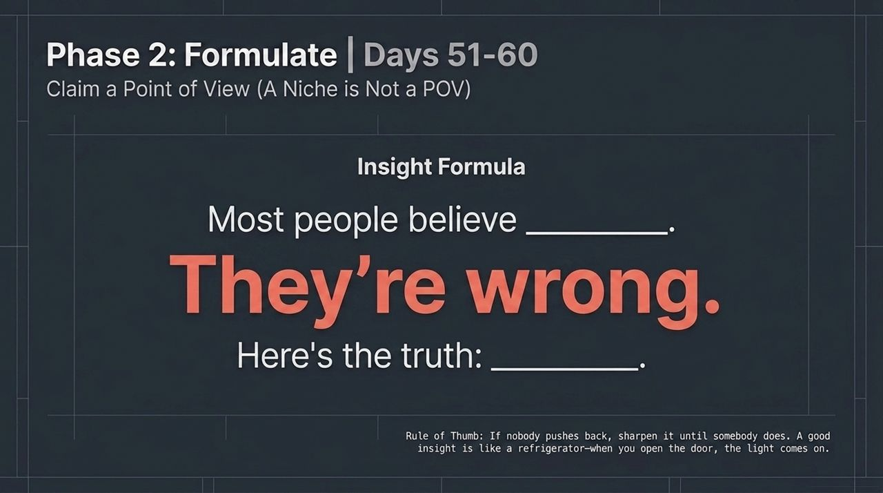
Notes:
During Days 51 to 60, establish a clear Point of View (POV). Note that a niche defines who you serve, whereas a POV defines what you claim.
Use the Insight Formula:
'Most people believe [X]. They're wrong. Here's the truth: [Y].’
Think of Snickers' iconic campaign: 'You're not you when you're hungry.' It wasn't derived from asking for clever slogans; it came from an insight into how men call out unusual behavior in their peer group when hungry. That single POV generated $376 million in incremental sales. Rule of thumb: If no one pushes back against your insight, sharpen it until they do.

Slide 11
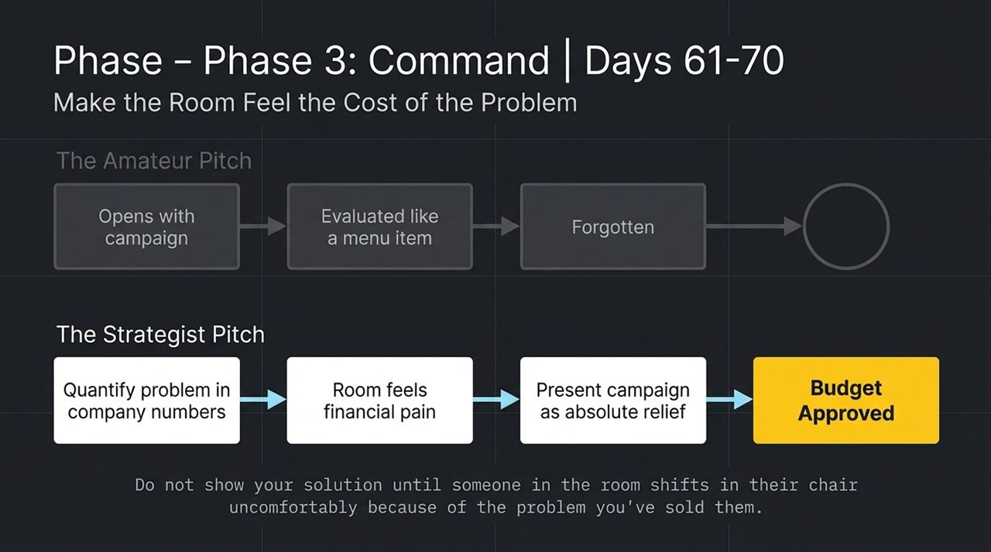
Notes:
Phase 3 is about executive influence. In Days 61 to 70, master the pitch by selling the problem before the solution.
The Amateur Pitch: Opens immediately with creative mockups or campaign ideas. The room treats it like a menu item, dissecting taste and details politely.
The Strategist Pitch: Dedicates slides 1 through 3 strictly to quantifying the financial and business cost of the core problem.
Do not present your campaign until key stakeholders uncomfortably feel the cost of inaction. When the room feels the financial pain, your campaign is received as absolute relief, making budget approvals effortless.

Slide 12
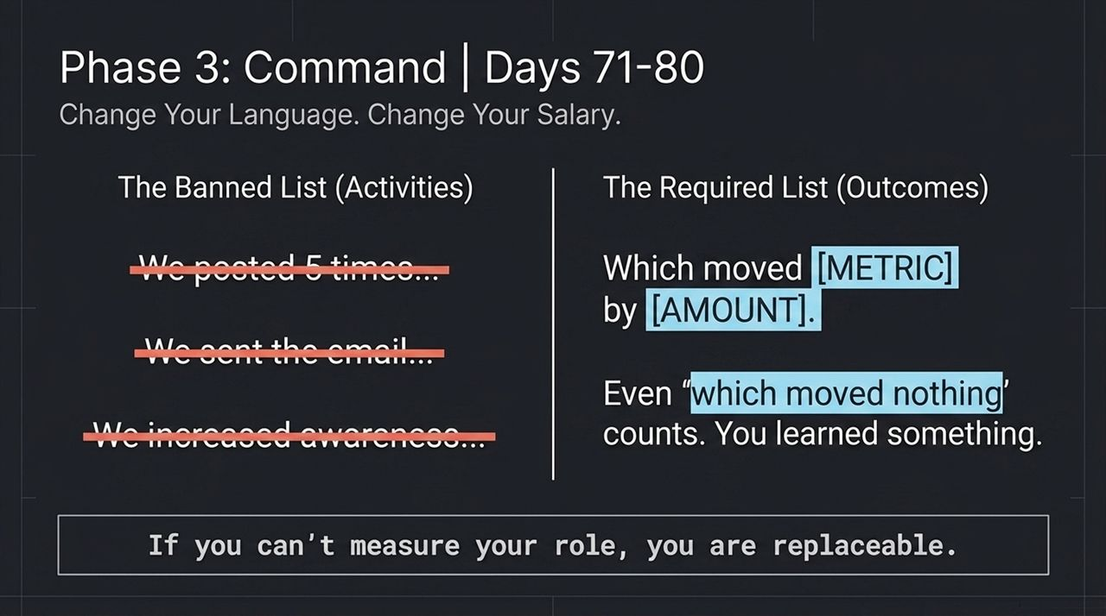
Notes:
For Days 71 to 80, purge activity-centric language from your vocabulary. Top earners and highly valued strategists speak exclusively in business outcomes.
The Banned List (Activities): 'We posted 5 times,' 'We sent the email newsletter,' 'We drove awareness.'
The Required List (Outcomes): '...which moved [METRIC] by [AMOUNT].'
Even if a test yielded flat results, phrase it as a win: 'Which moved nothing, proving hypothesis X incorrect and saving us Y budget.' If you cannot measure or state your role in terms of financial impact, you remain easily replaceable.

Slide 13
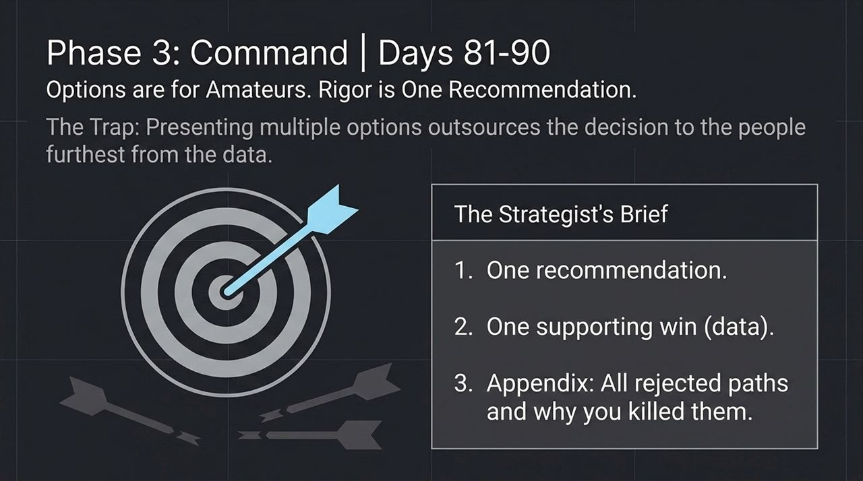
Notes:
In the final stretch (Days 81–90), eliminate the habit of presenting options.
The Trap: Marketers often present Options A, B, and C under the guise of being 'collaborative'. In reality, you are outsourcing the hardest part of your job—decision-making—to executives who are furthest from the daily data.
The Strategist’s Brief: Present ONE clear, data-backed recommendation. Include one supporting win. Move all alternative ideas and rejected paths into the Appendix, explicitly detailing why you killed them.

Slide 14
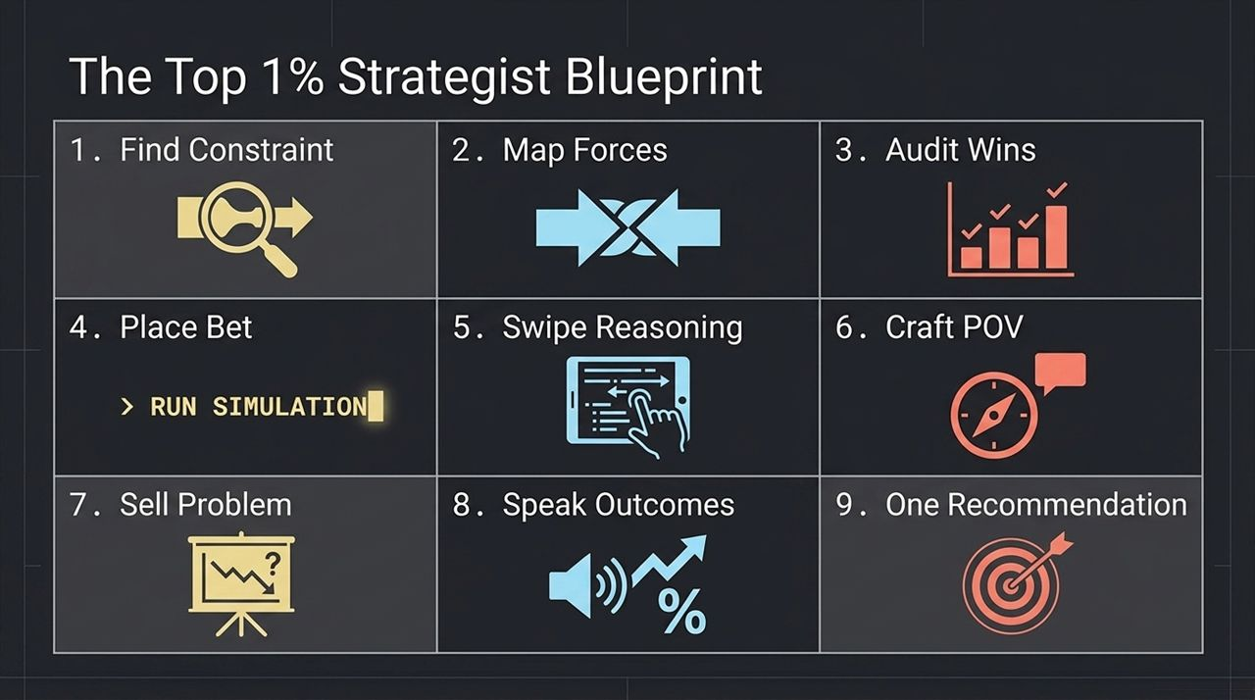
Notes:
To action directly to metric performance.
One Recommendsummarize our roadmap, here is the complete 9-step system working in unison:
Find Constraint: Isolate the single weak link.
Map Forces: Balance Push/Pull against Anxiety/Habit.
Audit Wins: Maximize current assets using More > Better > New.
Place Bet: Define your explicit belief and wager.
Swipe Reasoning: Store strategic rationale, not visual mood boards.
Craft POV: State a bold insight that challenges common belief.
Sell Problem: Quantify financial pain before showing solutions.
Speak Outcomes: Tie every ation: Deliver singular, rigorous direction.

Slide 15
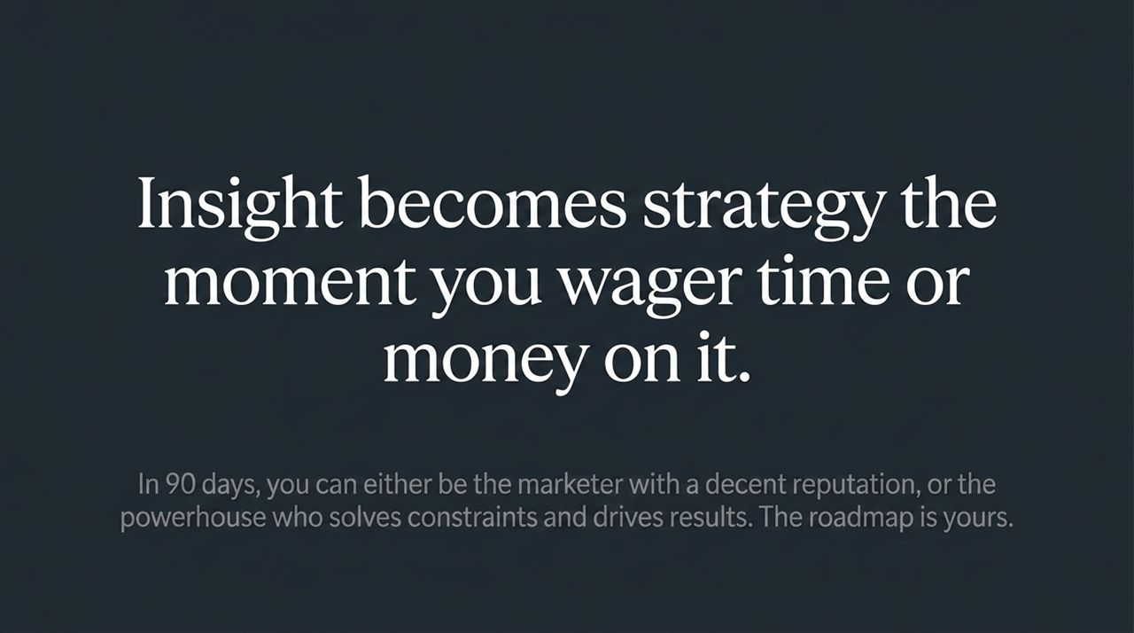
Notes:
As we close out the blueprint, remember this foundational principle: Insight becomes strategy the moment you wager time or money on it.
Strategy is not an intellectual exercise or a deck full of theoretical ideas. It is the deliberate commitment of real organizational resources to eliminate growth constraints. Over the next 90 days, you can continue operating as a standard marketer with decent campaign output, or you can step up as a powerhouse strategist who systematically solves constraints and drives revenue growth.

Slide 16
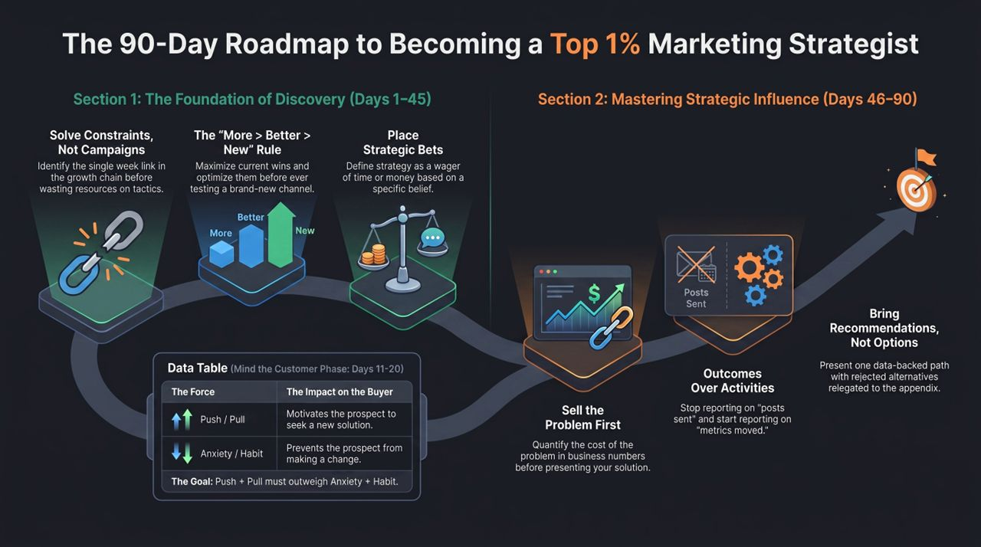
Notes:
Here is your operational cheat sheet divided across both core sections:
Section 1: The Foundation of Discovery (Days 1–45): Focus heavily on solving constraints over building tactical campaigns. Adhere strictly to the More > Better > New framework. Place strategic bets, and utilize customer qualitative forces (Push/Pull vs. Anxiety/Habit) to inform your positioning.
Section 2: Mastering Strategic Influence (Days 46–90): Shift into execution and leadership. Sell the problem first. Shift reporting from activities ('posts sent') to hard business outcomes ('metrics moved'). Always present one singular recommendation backed by rigorous data.
Execute this roadmap over the next 90 days to transform your career trajectory and team impact.

